Slide 1
Assam procurements data engineering.
The problem statement
To create a robust data system that hosts the procurement data of Assam state government
To identify the tenders related to flood management through key word search
To develop intelligent rule based algorithms to identify the rivers on which tenders are announced
To develop a data ecosystem that enables data driven decision making on flood management.
Notes:
15 such sheets

Slide 2

Choosing the database
“3 db admins walked into a NoSQL bar. They walked out because they did not find a Table” – Random db meme
Requirements \ DB | SQL (Postgres) | NoSQL (Cassandra, MongoDB)
Not Big Data | This is not a big data application. Postgres on a single server would be sufficient to store it. | Data can be stored on tabular no-SQL databases like Cassandra
Wouldn’t require horizontal scalability | There is no chance for mass demand of this data. At best, vertical scaling can be done by installing Postgres on a better server | Better suited when scalability is needed. Otherwise it is unnecessary complexity.
Optimise for queries by the research team | Since SQL is more popular – data can be easily queried from Postgres | Analysts should be trained in other query languages like CQL, MQL
Open source | Available | Available
GIS integration | POST GIS extension is available on Postgres. It can store both vector and raster data that we would need when be build the entire data ecosystem. | Available but not as well developed as POST GIS. However, if a lot of raster data has to be stored, MongoDB would be helpful.
Python integration | Available | Available
Going ahead with Postgres – as it’s a single database that fulfils all the needs of the project. If a lot of satellite imagery has to be stored at any point of time, MongoDB/S3 would be used and file keys will be stored in Postgres.
Notes:
15 such sheets

Slide 3
Schema design
“An architect’s dream is an engineer’s nightmare” – Wila O'Chariss
This database will be used to dump the procurements data scraped from government websites. Hence, it has to be optimised for INSERTION, and I assume that there is no major UPDATION or DELETION that takes place in this data.
If there is any UPDATION, I assume it can happen in the columns “tender_stage” and “tender_columns”. I hence separated these two columns to a separate table – so that the main query table can be write protected.
It is given that the data is already standardised, probably just after web-scraping is done. So I haven’t performed any major data quality checks that would involve libraries like great expectations.
The primary user of the database is the research team. Hence the design is optimised for queries rather than transactions, thus allowing for some data redundancy.
Assumptions taken behind the design
Notes:
15 such sheets

Slide 4
Schema design
“An architect’s dream is an engineer’s nightmare” – Wila O'Chariss
Table name: tenders_static
ocid (PK)
….
tender_externalreference
tender_title
….
tender_datepublished
….
buyer_name
Table name: tenders_update
ocid (FK)
date
tender_stage
tender_status
Table name: assam_rivers
id (PK)
river_name
Table name: tenders_flood
id (PK)
ocid (FK)
Table name: tender_river
id (PK)
ocid (FK)
river_id (FK)
Notes:
15 such sheets

Slide 5
Schema design
“Normalize till it hurts, Denormalize till it works.” – DB wise man.
1st NORMAL FORM CHECK
Removed duplicate rows
All columns are single valued – except for tender_externalreference. Should figure out a way to split this column
All columns are homogenous
2nd NORMAL FORM CHECK
The given dataset has a single PK (ocid) and non-primary keys in the given dataset are fully dependant on it. There is no partial dependency.
Nevertheless, created a separate table for those columns that might require updates to address any probable update anomalies.
3rd NORMAL FORM CHECK
In my exploration of the given data, I have not found any transitive dependency between any of the fields.
By the new fields that would be needed (floods, rivers) would create redundancy – hence new tables are created for this (tenders_flood, tenders_river)
Notes:
15 such sheets

Slide 6






System design
Say those three magical words: “Extract Transform Load”
Data scraped and cleaned
Upload csv to S3 using FastAPI
Transform
Extract
Load
Prefect workflow that performs ETL
Notes:
15 such sheets

Slide 7
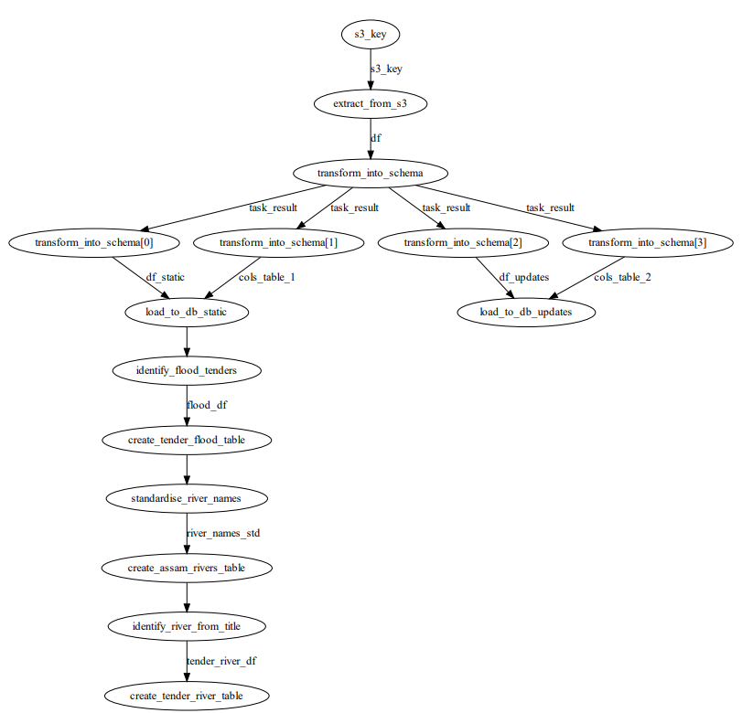
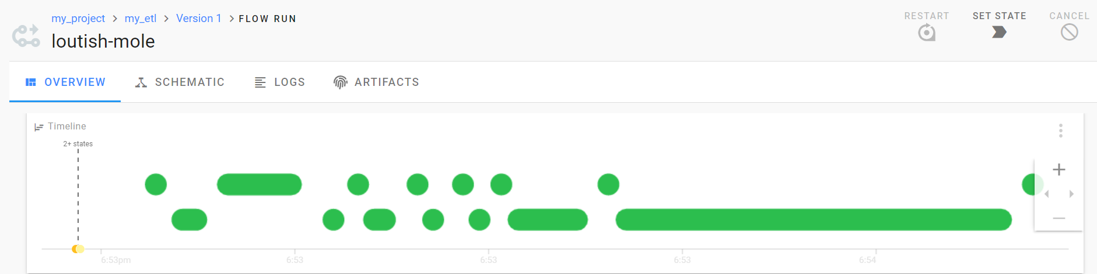
Prefect workflow
Perfect workflow
Notes:
15 such sheets

Slide 8
Next steps
Integration of the data-scraping engine with the work-flow to achieve end-to-end automation.
The “assam_rivers” table would need a manual quality check to further standardise river names.
Identification of districts and other granular aspects from the “tender_externalreference” field.
Host district level data (demographic, flood related – MNDWI) on the database to make it a one-stop data solution for flood information.
Notes:
15 such sheets

